Slide 1

gvSIG Use Cases
Alvaro Anguix
aanguix@gvsig.com

Slide 2

Case Studies
http://outreach.gvsig.org/case-studies

Slide 3
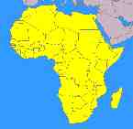
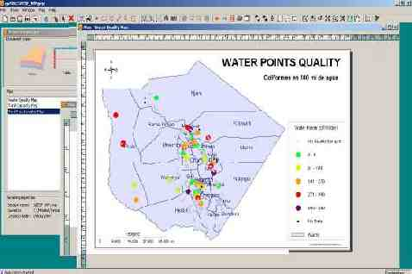
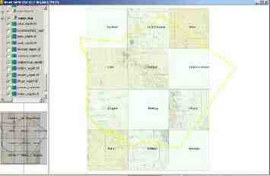
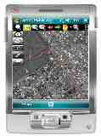
Africa
Tanzania: GIS of hydro-sanitary program of Same district. gvSIG Desktop.
Uganda: management of water networks. gvSIG Desktop
Gambia: Data collection process. World Food Programme. gvSIG Mobile.
South Africa: gvSIG in Education. Collaborator company.
Users in Tunisia, Egypt, Morocco...

Slide 4
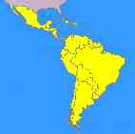
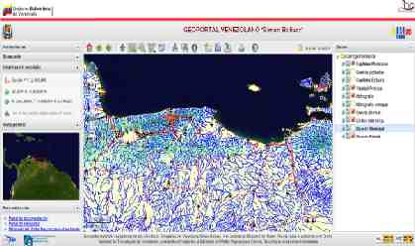
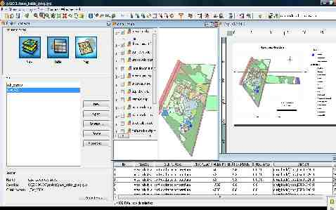
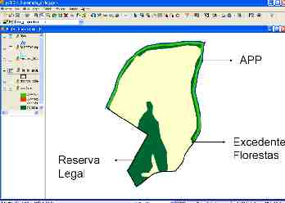
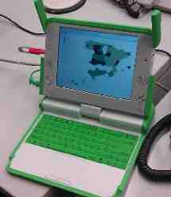
Latin America
Honduras, El Salvador: gvSIG Fonsagua. GIS application to manage water and sanitation programs. ISF.
Venezuela: Spatial Data Infrastructure of Venezuela
Uruguay: “Plan Ceibal” One Laptop Per Child.
Brasil: forest management.
Users around Latin America...

Slide 5
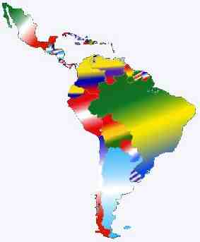
Latin American and Caribbean gvSIG Conference
Cuba Forest management
History GIS
Ciudad de la Habana
Evaluation of “Mariposa Monarca” reserve
Local management (Guatemala)
Catastral manag. (Méx.)
Local management (Honduras)
Water management (Venezuela)
Gardens & Infrastructures manag. (Col)
Hydroelectric management (Ven)
Risk Management (Com. Andina)
Environment Monitoring (Ar)
Evo Cumple Program manag. (Bol)
SDI Santa Fe
Yerba-mate production manag. (Br)
Urban infrastructures manag. (Ar)
Politicas de habitação de interesse social
Transformação de Chuva em Vazão
na sub-bacia.do Rio Pariquera-Açu
Risk Management (Ar)
Environmental Atlas
Catastral management (Ar)
Birds population
management
Census data analysis
Surveying use

Slide 6
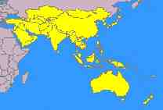
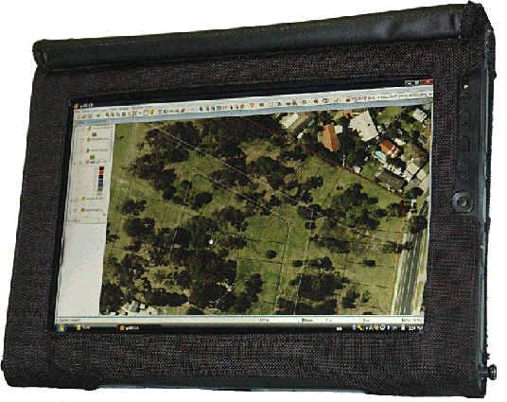
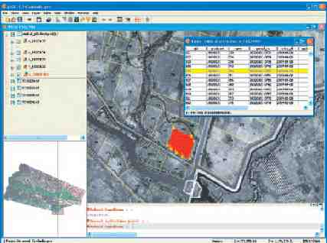
Asia & Oceania
Australia: Enviromental uses
New Zealand: Electric company
Japan: gvSIG Training
Cambodia: Catastral management.
Users in India, China, South Corea,....

Slide 7
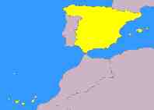
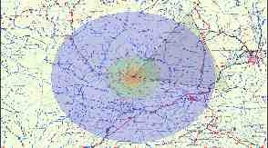
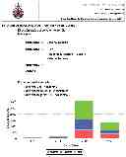
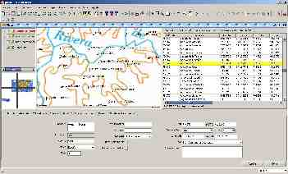
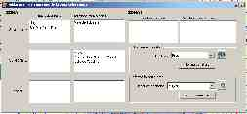
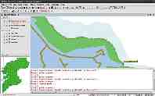
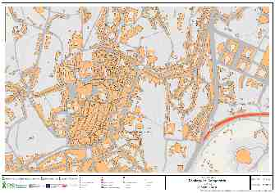
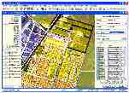
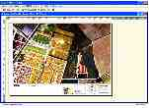
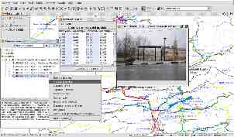
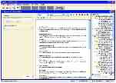
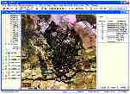
Europe (Spain)
Central Administration: IGN, Ministry of the Environment and Rural and Marine Affairs, Ministry of Public Works, Ministry of Science and Innovation, AECID, CSIC, …
Regional Administration: Junta de Andalucía, Junta de Extremadura, Generalitat Valenciana, Gobierno de La Rioja, Gobierno Vasco,...
Local Administration: Diputación de Málaga, Dip. de Pontevedra, Dip. de Jaén,...

Slide 8
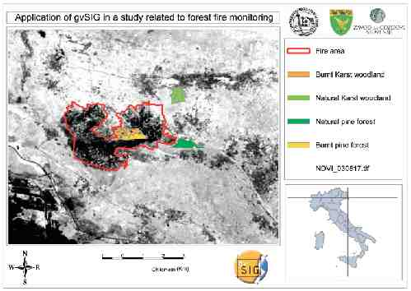
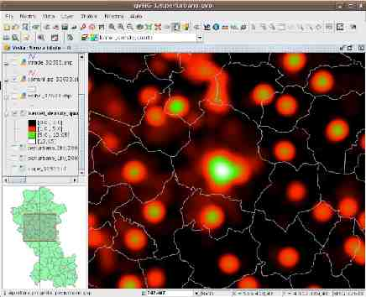
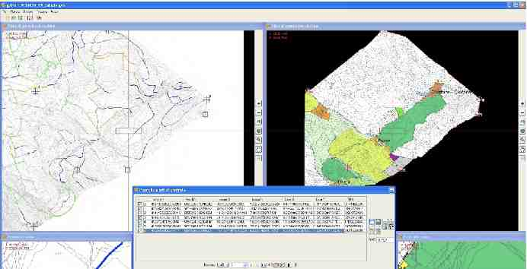
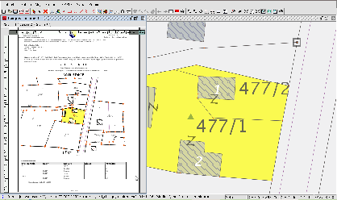
Europe (France, Italy, Uk, Germany...)

Slide 9
Thank you very much!!!
Association for the promotion of FOSS4G and the development of gvSIG
Alvaro Anguix
aanguix@gvsig.com

